Slide 1
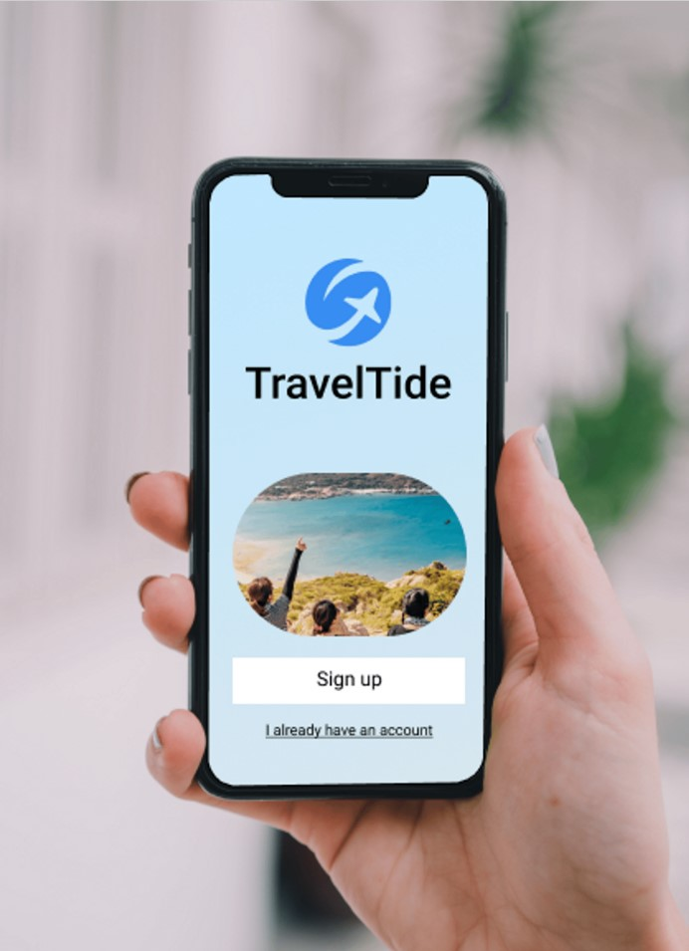
Traveltide Crafting a Personalized Rewards Program to Boost Customer Loyalty
Date: 06 September 2024
Analyst: Anju Thomas

Slide 2
OBJECTIVES
Enhance Customer Retention
Validate and Personalize Rewards
Optimize Marketing Strategies

Slide 3
DATA OVERVIEW & PREPROCESSING
Data Source: Sessions from January 4, 2023, to July 23, 2023.
Inclusion Criteria: Users with more than 7 sessions.
Data Cleaning:
Outliers: Identified in base_fare_usd and page_clicks.
Visualizations: Box plots and histograms used for outlier detection.

Slide 4
CUSTOMER SEGMENTATION & CLUSTERING
Segmentation Approach:
Methods Used: K-Means and Fuzzy Clustering.
Criteria: Segmentation based on customer behaviour and preferences.
Customer Segments:
Budget Travelers
Selective Spenders
Frequent Travelers
Comprehensive Experience Seekers

Slide 5
PERK DISTRIBUTION ACROSS SEGMENTS
Perk Assignment:
Perks count
No Cancellation Fee 1253
Free Checked Bags 1180
Exclusive Discount 1113
One Night Free Hotel 791
Free Hotel Meals 703
Distribution Insight: Tailoring perks based on segment preferences.

Slide 6
KEY INSIGHTS & RECOMMENDATIONS
Key Insights:
Customer segments have distinct perk preferences.
Personalization enhances customer engagement and loyalty.
Recommendations:
Multi-Tiered Perks
Targeted Marketing
Location-Based Customization

Slide 7
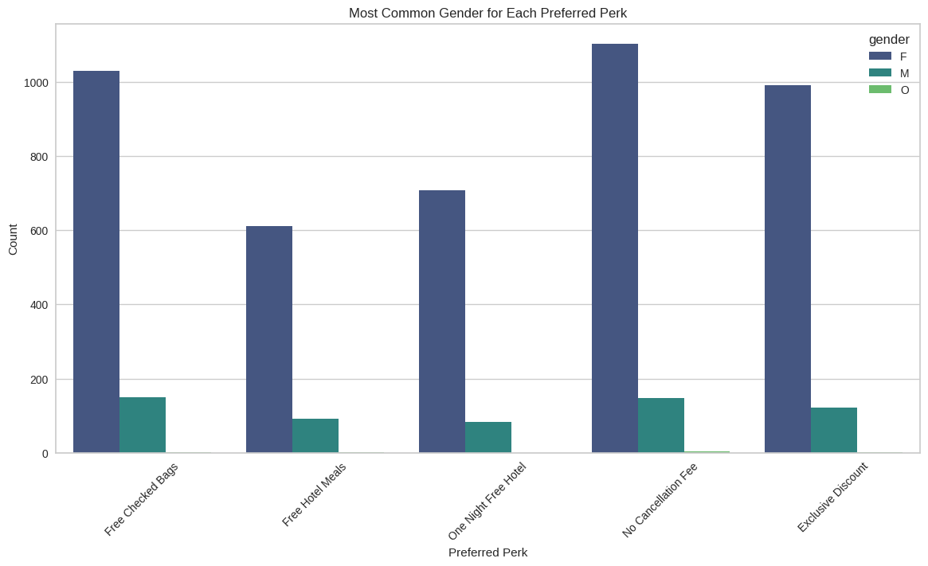
PREFERRED PERK: GENDER

Slide 8
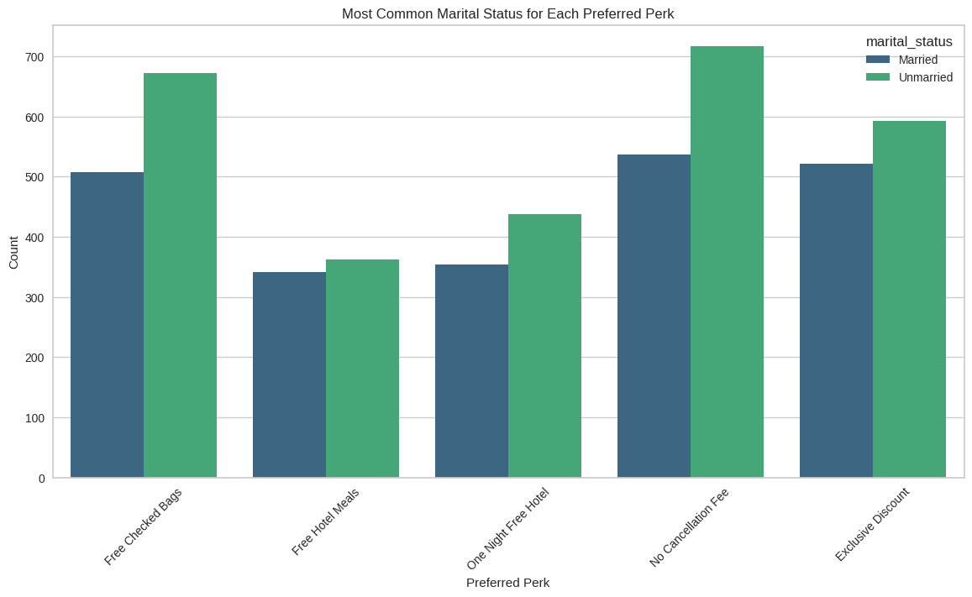
PREFERRED PERK: MARITAL STATUS

Slide 9
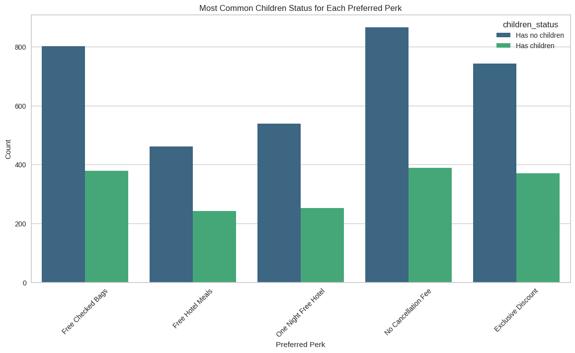
PREFERRED PERK: CHILDREN STATUS

Slide 10
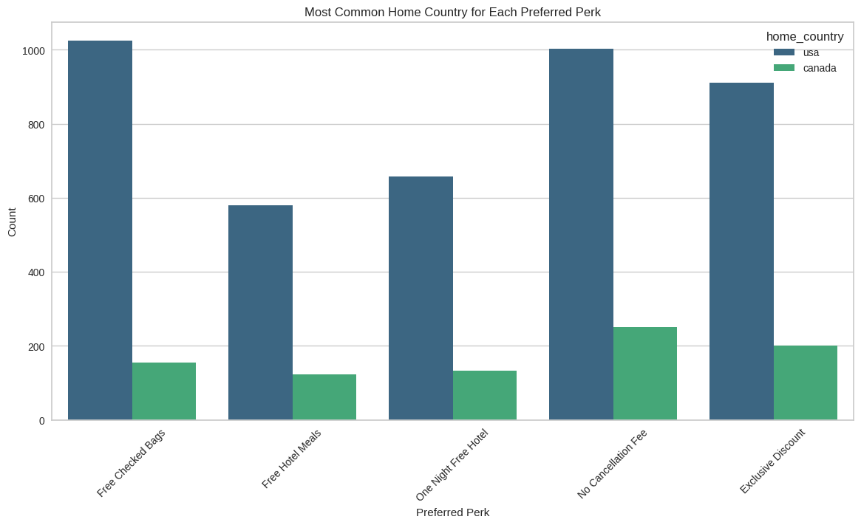
PREFERRED PERK: HOME COUNTRY

Slide 11
THANK YOU!

